Slide 1
Locating the Ideal Location for New Pizzeria in Wake County, North Carolina
IBM Data Science Professional Certification
Capstone Project
By Mark Trimer
June 2020

Slide 2

Background
Wake County is located in central North Carolina. Its largest city is Raleigh, the state capital. Along with eleven other municipalities that surround Raleigh, Wake County has a population of 1.1M, making it the most populated county in North Carolina. It is also home to the largest school district in the state.
Within a half-day’s drive from both the mountains and the ocean, and midway along the Atlantic seaboard, Wake County’s location is ideal to access many points of interest. Ranking 3rd for the Best Counties to Live in America, 14th for Best Counties for Families in America, and combined with low unemployment, Wake County has experienced phenomenal population growth.
Recently, a friend has decided to move to Wake County and start a pizzeria. In order to help, an analysis will be created to pinpoint the top-5 locations in the county to open the shop.

Slide 3
Problem Statement
In order to find the best potential locations, one of the factors will be to find dense population centers which lack pizzerias. This approach should maximize clientele while minimizing competition.
This analysis will uncover a metric to calculate and locate where the top-5 potential locations should be, through analytics of data from multiple sources.
With that said, other factors should come into play, too, in order to find the best potential locations. However, these are out of scope for this analysis but are discussed briefly later in the document.
The ideal audience for this analysis would be any entrepreneur looking to open a pizzeria in Wake County. The approach, though, could then be easily modified to accommodate any cuisine or location.

Slide 4
Data Sources
Two data sources will be used.
1) Wake County Open Data (http://data-wake.opendata.arcgis.com/)
This resource contains a wealth of data about Wake County, including properties, parks, education, public safety, and zoning data. Of interest, it contains demographic information. Specifically, one table includes 2010 census data by census tract. This table includes the area of the tract and population. This is ideal to calculate segmented population density throughout the county. (http://data-wake.opendata.arcgis.com/datasets/census-tracts-2010)
2) Foursquare (https://developer.foursquare.com/)
A comprehensive resource of crowd-sourced data, Foursquare will be leveraged to find all the pizzeria locations in Wake County via its developer portal.

Slide 5
Approach
Using the Wake County Census Tract Data, obtain population and area (km²), along with longitude and latitude of each tract. This is ideal for calculating relative population density throughout the county.
Census Tract is an excellent a proxy for neighborhood data, especially considering customers will be coming various neighborhoods. Wake County does not have boroughs.
Using Foursquare, pull all the restaurants in Wake County that can be keyed on Italian cuisine or pizza, along with its location.
Further refine the list, as the entrepreneur believes his pizza product and its unique recipe stands alone. Therefore, he does NOT consider national chains to be direct competitors. The Foursquare data will be scrubbed to exclude the following: Papa John’s, Domino’s, Little Caesar’s, and Pizza Hut.
Merge the two data sets on longitude and latitude. For the location of each Census Tract, count the number of pizzerias and Italian restaurants within a 5-kilometer radius. This is roughly the extent of current delivery radii and translates into a 10-minute drive.
Calculate the population per square kilometer and divide it by the number of competitor locations. This provides the maximum number of potential customers within close driving proximity to the location, relative to competing restaurants.
Sort this metric in descending order and document the location of the top-5 census tracts. A higher metric translates into higher potential customer-base with minimal competition.

Slide 6
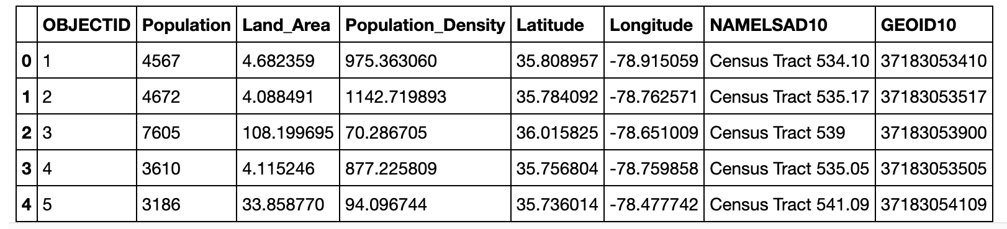
The Data – Wake County Census Tracts
Accessing the Wake County Census Tract Data, population, area (km²), longitude and latitude information were gathered.
Data was downloaded, where it was scrubbed to delete unnecessary columns, to add calculated column for Population Density, and to improve the column header names. Here is a header of the dataframe:
The dataframe has 187 Census Tracts, labeled 1-187 under OBJECTID column. Each tract has a population count, density calculation, land area (in square kilometers), latitude and longitude. It’s important to note that the data is from the 2010 census.
This data set is ideal to discover the densest areas within the county, and where they are located. Again, Census Tract data is an excellent a proxy for neighborhood data, especially considering customers will be coming various neighborhoods.

Slide 7
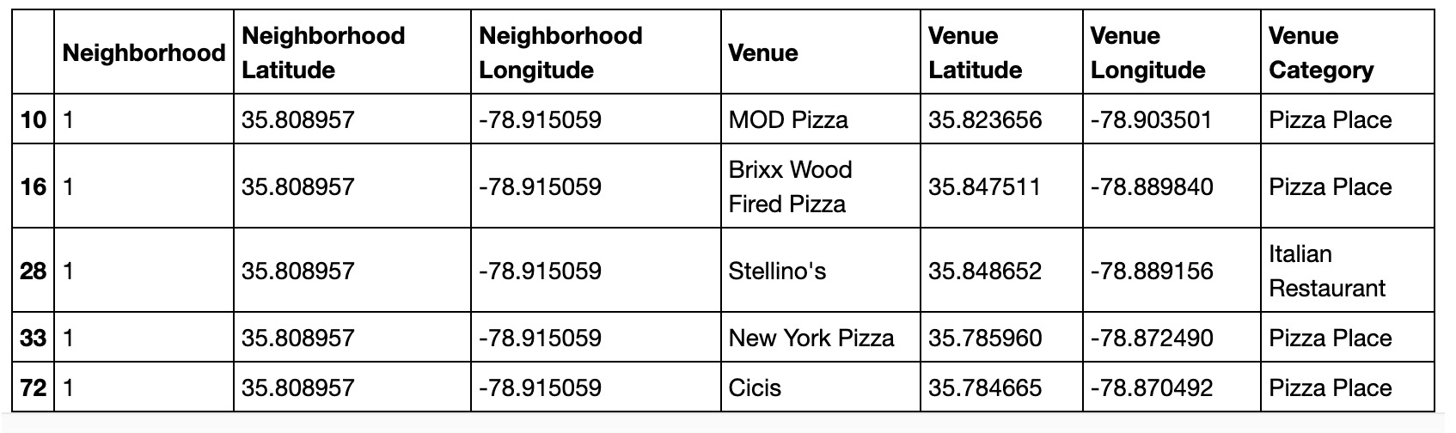
The Data – Foursquare
The second source accessed was Foursquare, in order to obtain all the venues in Wake County filtered on Italian cuisine or pizza, along with its location.
The initial data pull accesses all the venues within a 5km radius of each Census tract. Five kilometers is roughly a 10-minute drive, and the extent of a pizza delivery range.
The initial pull identified 16,047 venues across the 187 Census tracts. The venue list was refined as follows:
Pare down on the Venue Category column to only include pizzerias and Italian restaurants.
Pare down the Venue to exclude the following: Papa John’s, Domino’s, Little Caesar’s, and Pizza Hut, as mentioned since these are not considered direct competitors.
After this scrub, 852 venues throughout the county were left to consider. These are essentially the competitors. Here is a header of the data frame:

Slide 8
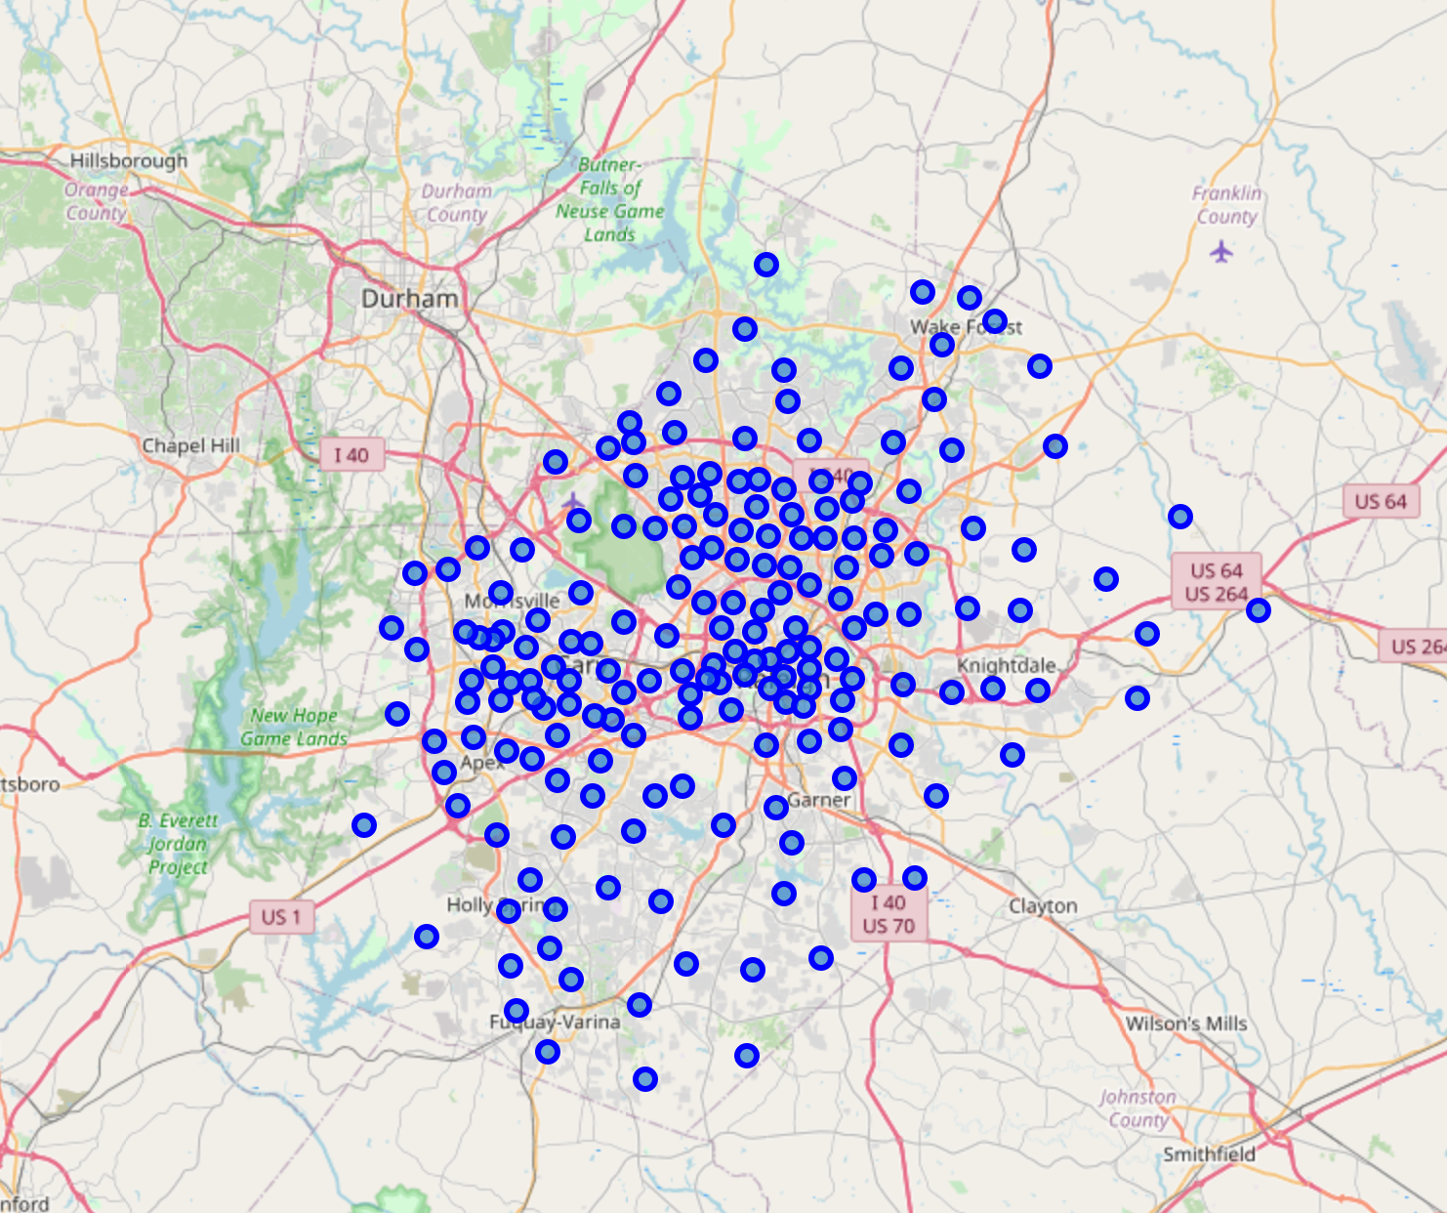
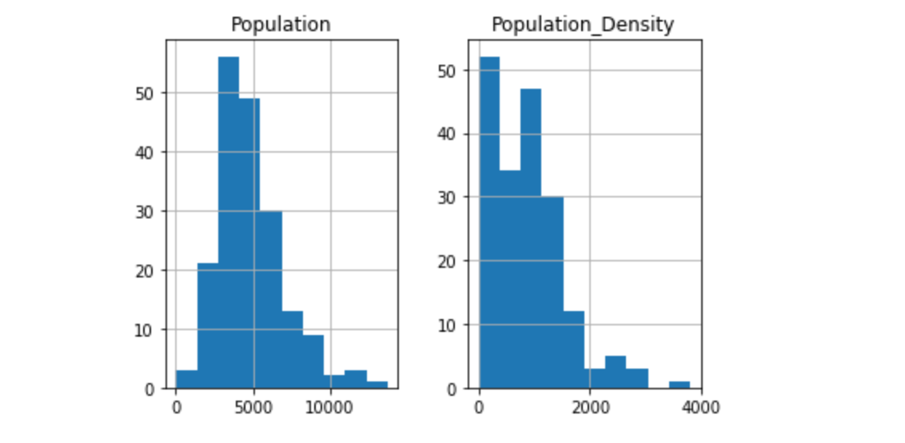
Data Exploration 1
The Wake County Census tracts are located as follows throughout the county:
The population and Population Density of each Census tract appears as follows in a histogram.
Not much can be gleaned from these histograms. There are a few outliers, but nothing to insightful.

Slide 9
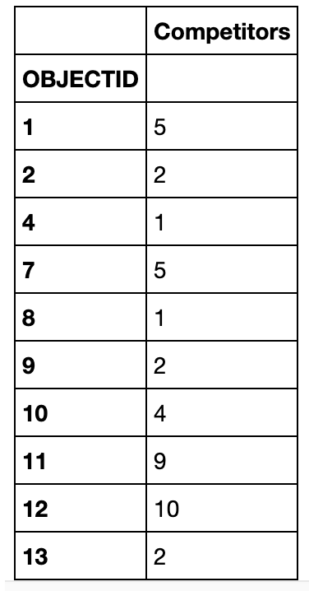
Data Exploration 2
The Foursquare data must be grouped by neighborhood, so number of nearby competitors can be calculated more efficiently. The 852 competitors were grouped into each neighborhood. Column headings were updated.
Here is a header of the revised dataframe:

Slide 10
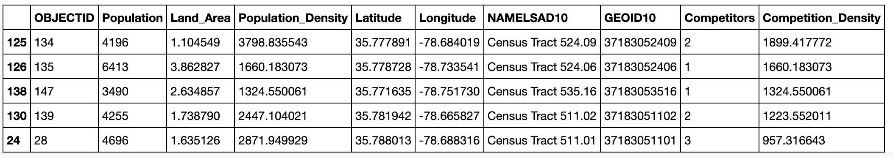
Analysis and Methodology
The two data frames must be merged into one data frame.
The following steps were taken.
Merge the Wake County Population by Census tract data frame with the Foursquare pizza and Italian restaurant dataframe. Merge them on the OBJECTID column.
Add a column called Competition Density, which takes the Population Density and divides it by the Competitors.
The Competition Density column is sorted in descending order.
The following dataframe was created. The header is as follows:
Of note, this dataframe only included 171 rows, not the original 187 rows. These 16 rows were dropped, because they had no competing venues. These were investigated further to ensure there are no missed opportunities. The population densities of each of these Census tracts, if an entrepreneur were to locate in any one of these locations, they are not dense enough, still, to consider. (See detailed report)

Slide 11
Competition Density Metric Discussion
The analysis and conclusion hinge on the definition of the Competition Density metric. Essentially, the entrepreneur wants to locate his new business where:
There is a high concentration of potential customers
The is minimal competing restaurants serving the same cuisine.
For example, two areas of the same size each has a population density of 1000 people per square kilometer.
Area 1 has 4 competing restaurants. Its competition density is 1000/4 = 250.
Area 2 has 8 competing restaurants. Its competition density is 1000/8 = 125.
Ideally, one would want to locate the new restaurant in Area 1. Its Competition Density is higher, and therefore the better choice in this analysis.

Slide 12
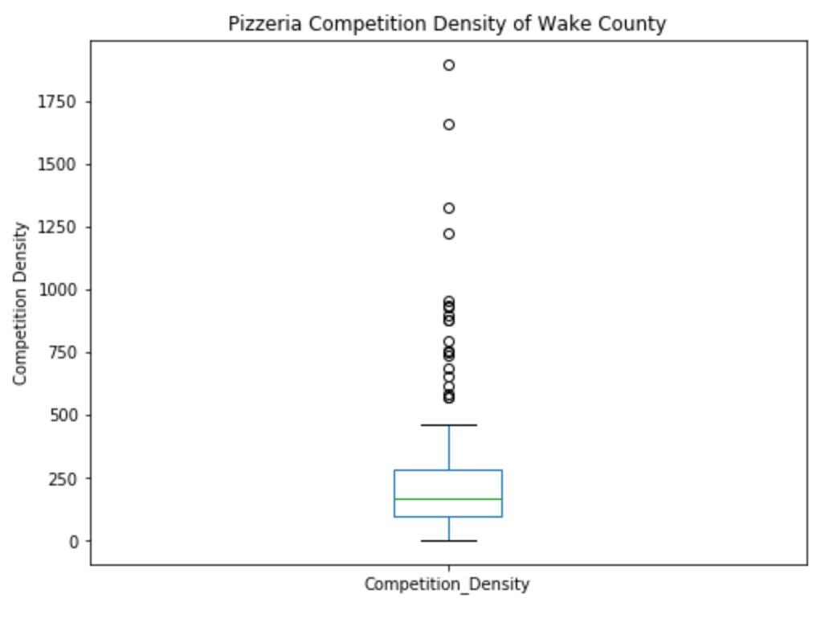
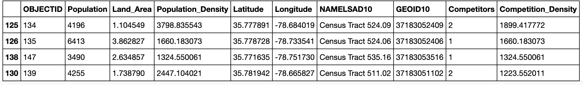
Discussion Wake County Competition Density Results
As seen in the write-up, a scatter plot and a histogram indicated some locations that were outliers. These were most evident in this Boxplot. Four (4) Census tracts are outliers. The conclusion will need to key on these locations.
Here are the details of these 4 locations. This is the answer to our problem statement:

Slide 13
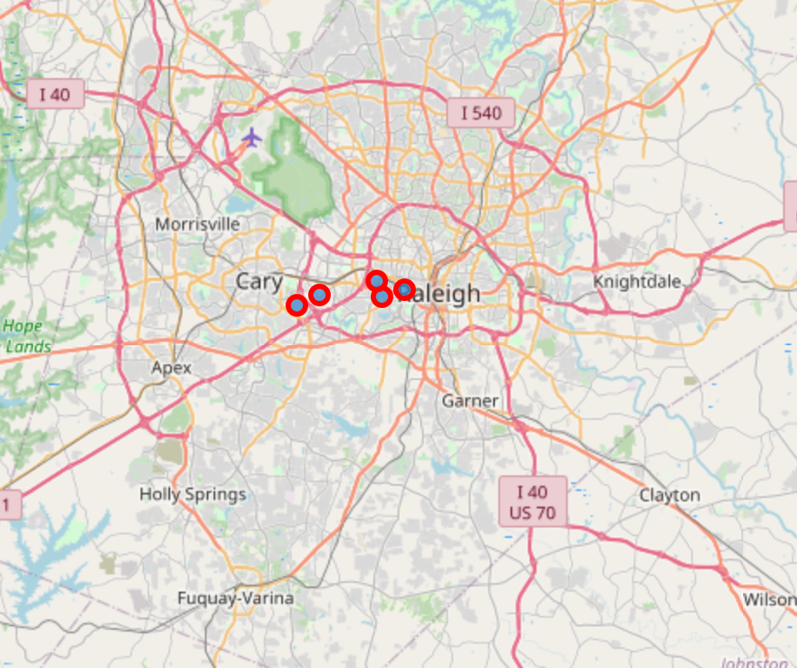
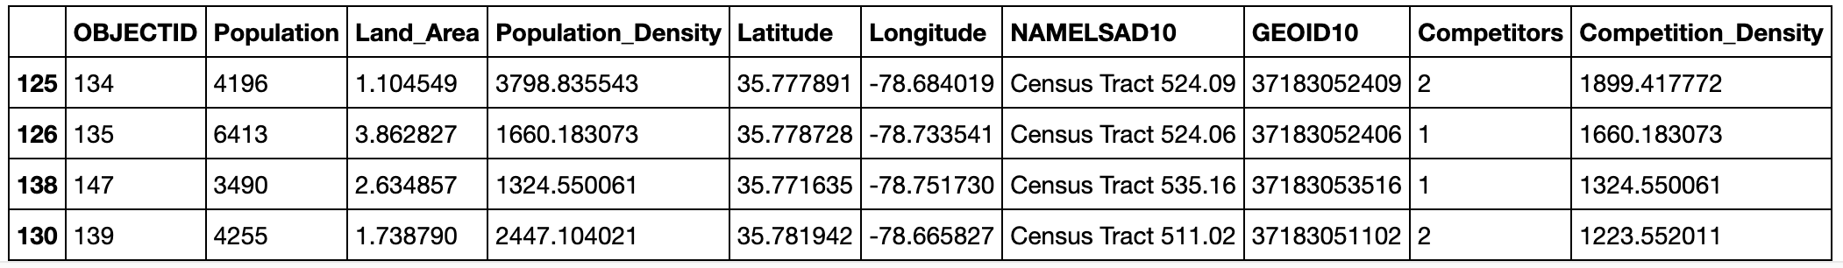
Insight and Conclusion
A recommendation is made to the pizzeria entrepreneur to consider only four (4) locations in Wake County. These locations maximize nearby potential customers, while minimizing existing competition. The following locations are provided.
Other Considerations:
Obviously, location is not the only consideration. Other factors that can be researched and weighed by the entrepreneur include:
Demographics – ensuring pizza and Italian cuisine are favored within the area
Income – does the area have adequate disposable income to support the restaurant
Real Estate Costs – rent is a substantial overhead to manage
Future Development Potential – is the area growing, or potentially ready to grow?
Density of Population – Is the Population density calculation skewed, as the Census tract is zoned commercial and industrial versus residential?
Refreshing analysis when 2020 census results are complete – Population data is nearly 10 years old and may not reflect substantial changes over the last decade

